Slide 1


AMAZON SECURITY

Slide 2
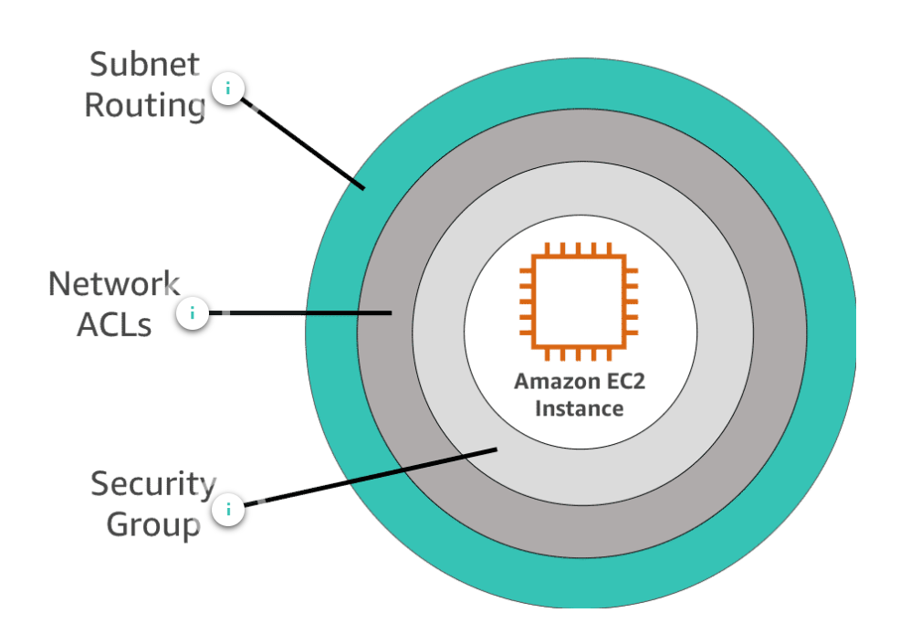

Infrastructure protection

Slide 3






Application and os security

Slide 4



Additional services
Firewall
Manager
Direct
Connect
Cloud
Formation

Slide 5
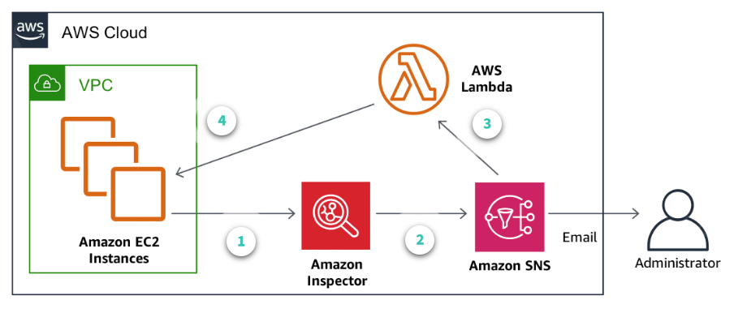

Additional services
Inspector
https://aws.amazon.com/blogs/security/how-to-remediate-amazon-inspector-security-findings-automatically/

Slide 6
Additional services
https://aws.amazon.com/blogs/security/how-to-remediate-amazon-inspector-security-findings-automatically/
https://aws.amazon.com/articles/tips-for-securing-your-ec2-instance/
https://docs.aws.amazon.com/inspector/latest/userguide/inspector_rule-packages.html

